Slide 1
Palletizing Application of Industrial Robot Arms
22.06.2022

Slide 2
CONTENTS
Scope of the Project
General Requirements
PLC, HMI
Robot
Image Proccessing
Results and Conclusion

Slide 3
Scope of the Project
Robotic and image processing techniques for palletizing systems will be combined in this project, resulting in more precise and quicker outcomes. The image processing algorithm will improve this project, which incorporates several controllers, by adding more diverse features and reducing cycle time. The system includes a robot, a PLC, an HMI, and a PC with an image processing algorithm. The image processing algorithm will measure the product's coordinates and orientation with the communication hub, datas will transferred to robot, then the robot will palletize the product.

Slide 4
General Requirements | Planning
In order to realize the system, following scenerio considered. While the product is coming from a conveyor belt driven by an asynchronous motor, it will be stopped by a sensor and the camera algorithm will measure the position and orientation of the product. After this step, the measured values will be sent to a 6-axis industrial robot via hub communication. After the robot picks up the product from the pick point, it will palletize it in the box.

Slide 5
General Requirements | Mechanical
A cabinet system will be created to implement the system. The reason for choosing the cabinet system is to create a compact structure. An aluminum profile, which is a light and strong material, was chosen for the body of the cabinet system to withstand various forces to be applied on it and the moment of inertia of the robot.

Slide 6
General Requirements | Robot Gripper and Product Selection
A metal lining part is chosen for example product for our system, the reason that is chosen is its an industrial part and it can be picked easily with magnets.
12 V DC Magnets and driving with PLC and relays.
Mechanical switch for sensing the part.

Slide 7
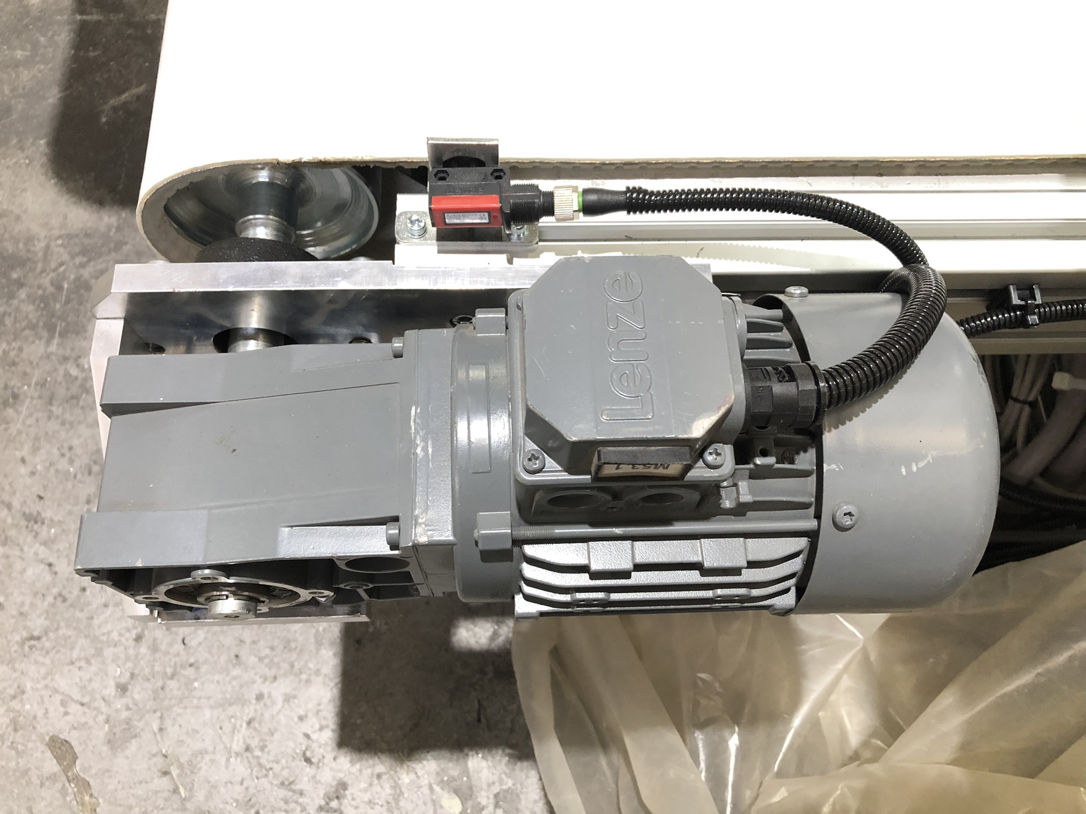
General Requirements | Motor
Lenze brand asynchronous motor used for driving the conveyor. The motor’s specification:
Nominal power: 0.37kW
Nominal speed: 1410 RPM
Gear ratio: 46
Output torque: 110 Nm
Output speed: 31 RPM
J = 0.027
Motor is driven by Siemens V20 motor driver
with parameters.

Slide 8
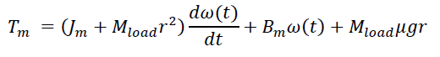
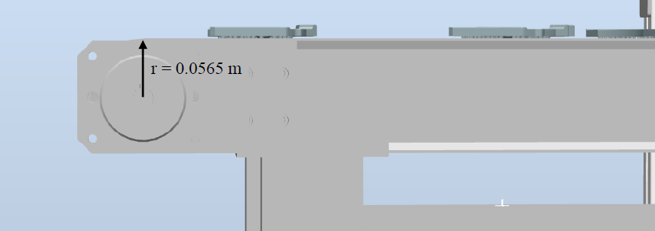
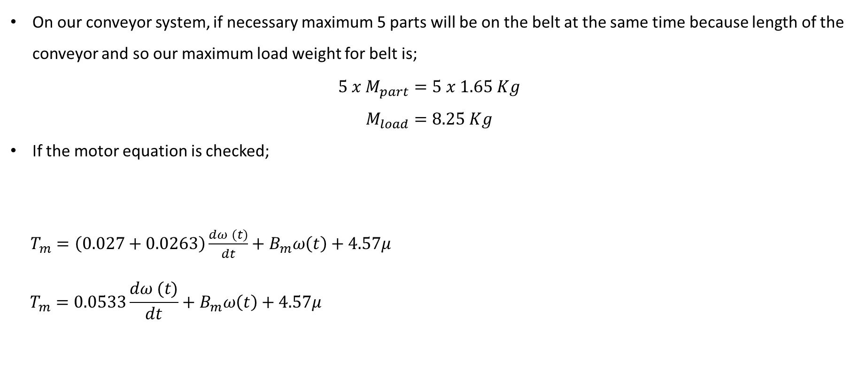
General Requirements | Motor
On our conveyor system, if necessary maximum 5 parts will be on the belt at the same time because length of the conveyor and so our maximum load weight for belt is;
$$5 x{ M}_{part}=5 x 1.65 Kg$$
$$M_{load}=8.25 Kg$$
If the motor equation is checked;
$T_{m}=\left(0.027+0.0263\right)\frac{dω (t)}{dt}+B_{m}ω\left(t\right)+4.57μ$
$$T_{m}=0.0533\frac{dω (t)}{dt}+B_{m}ω\left(t\right)+4.57μ$$

Slide 9
General Requirements | PLC
PLC has been chosen as the Master device that will control our system in general, because of the PLC's multiple input multiple output structure, communication speed, ease and 24V output feature. Considering our system, a PLC with a capacity of at least 10 inputs and 10 outputs was chosen, since there are not many inputs and outputs.

Slide 10
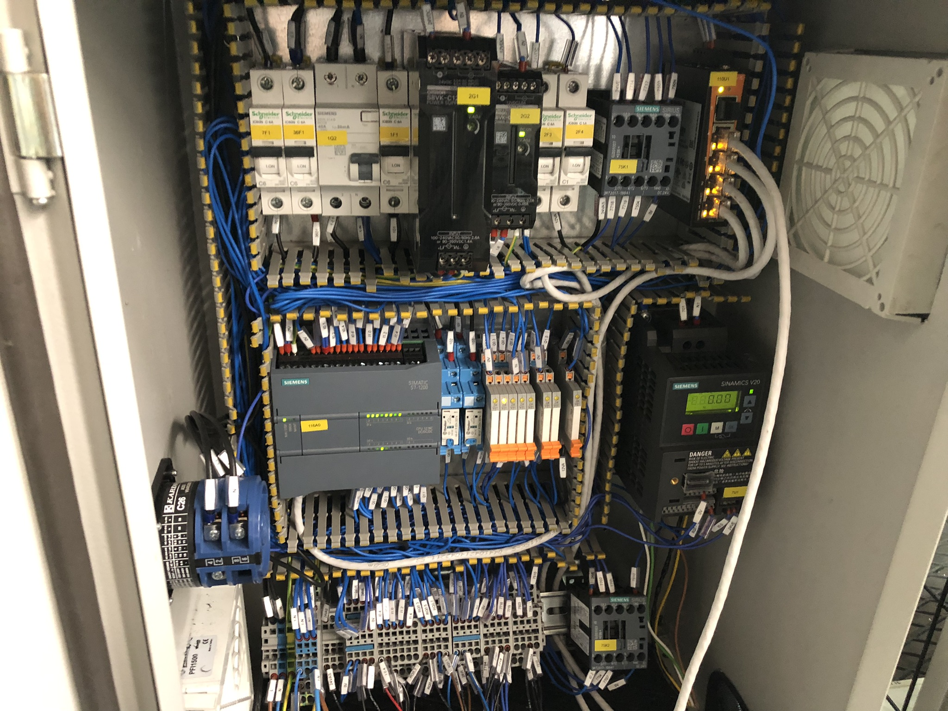
General Requirements | Electrification
Relay for the outputs.
Fuses for safety.
Terminals for the signals coming from the field.
24V DC and 12VDC power supplies for the devices.
Ethernet switch for HUB comminication.

Slide 11
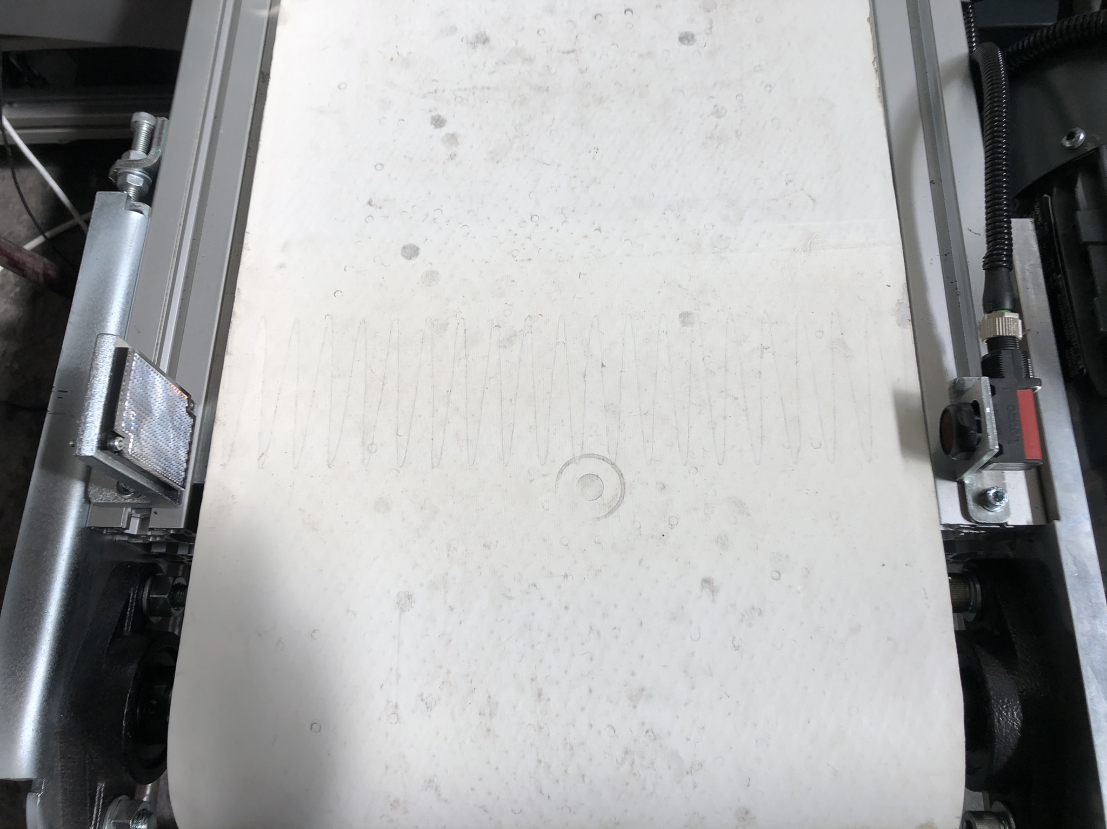
General Requirements | Sensors
Photocell sensors and signals for knowing loading and unloading the product.

Slide 12
General Requirements | Robot Arm Determination
ABB IRB1200 7kg - 0.7m reach is used as consignee robot.
The robot provided by ABB.
Mpart = 1.65 Kg and Mgripper = 3.4 Kg
Mtotal = 5.05 Kg
Reach and payload is enough for the project and cabin system.

Slide 13
General Requirements | Camera Determination and Communication
Logitech C310 webcam is chosen for the camera algorithm for simple and economic solution.
720p, 30fps, 1.2 MP
Ethernet IP based Profinet communication is chosen for PLC and Robot communication.
Snap7 library used for PC (Python) – PLC communication for sending coordinates.
Ethernet switch used for Ethernet communication.

Slide 14
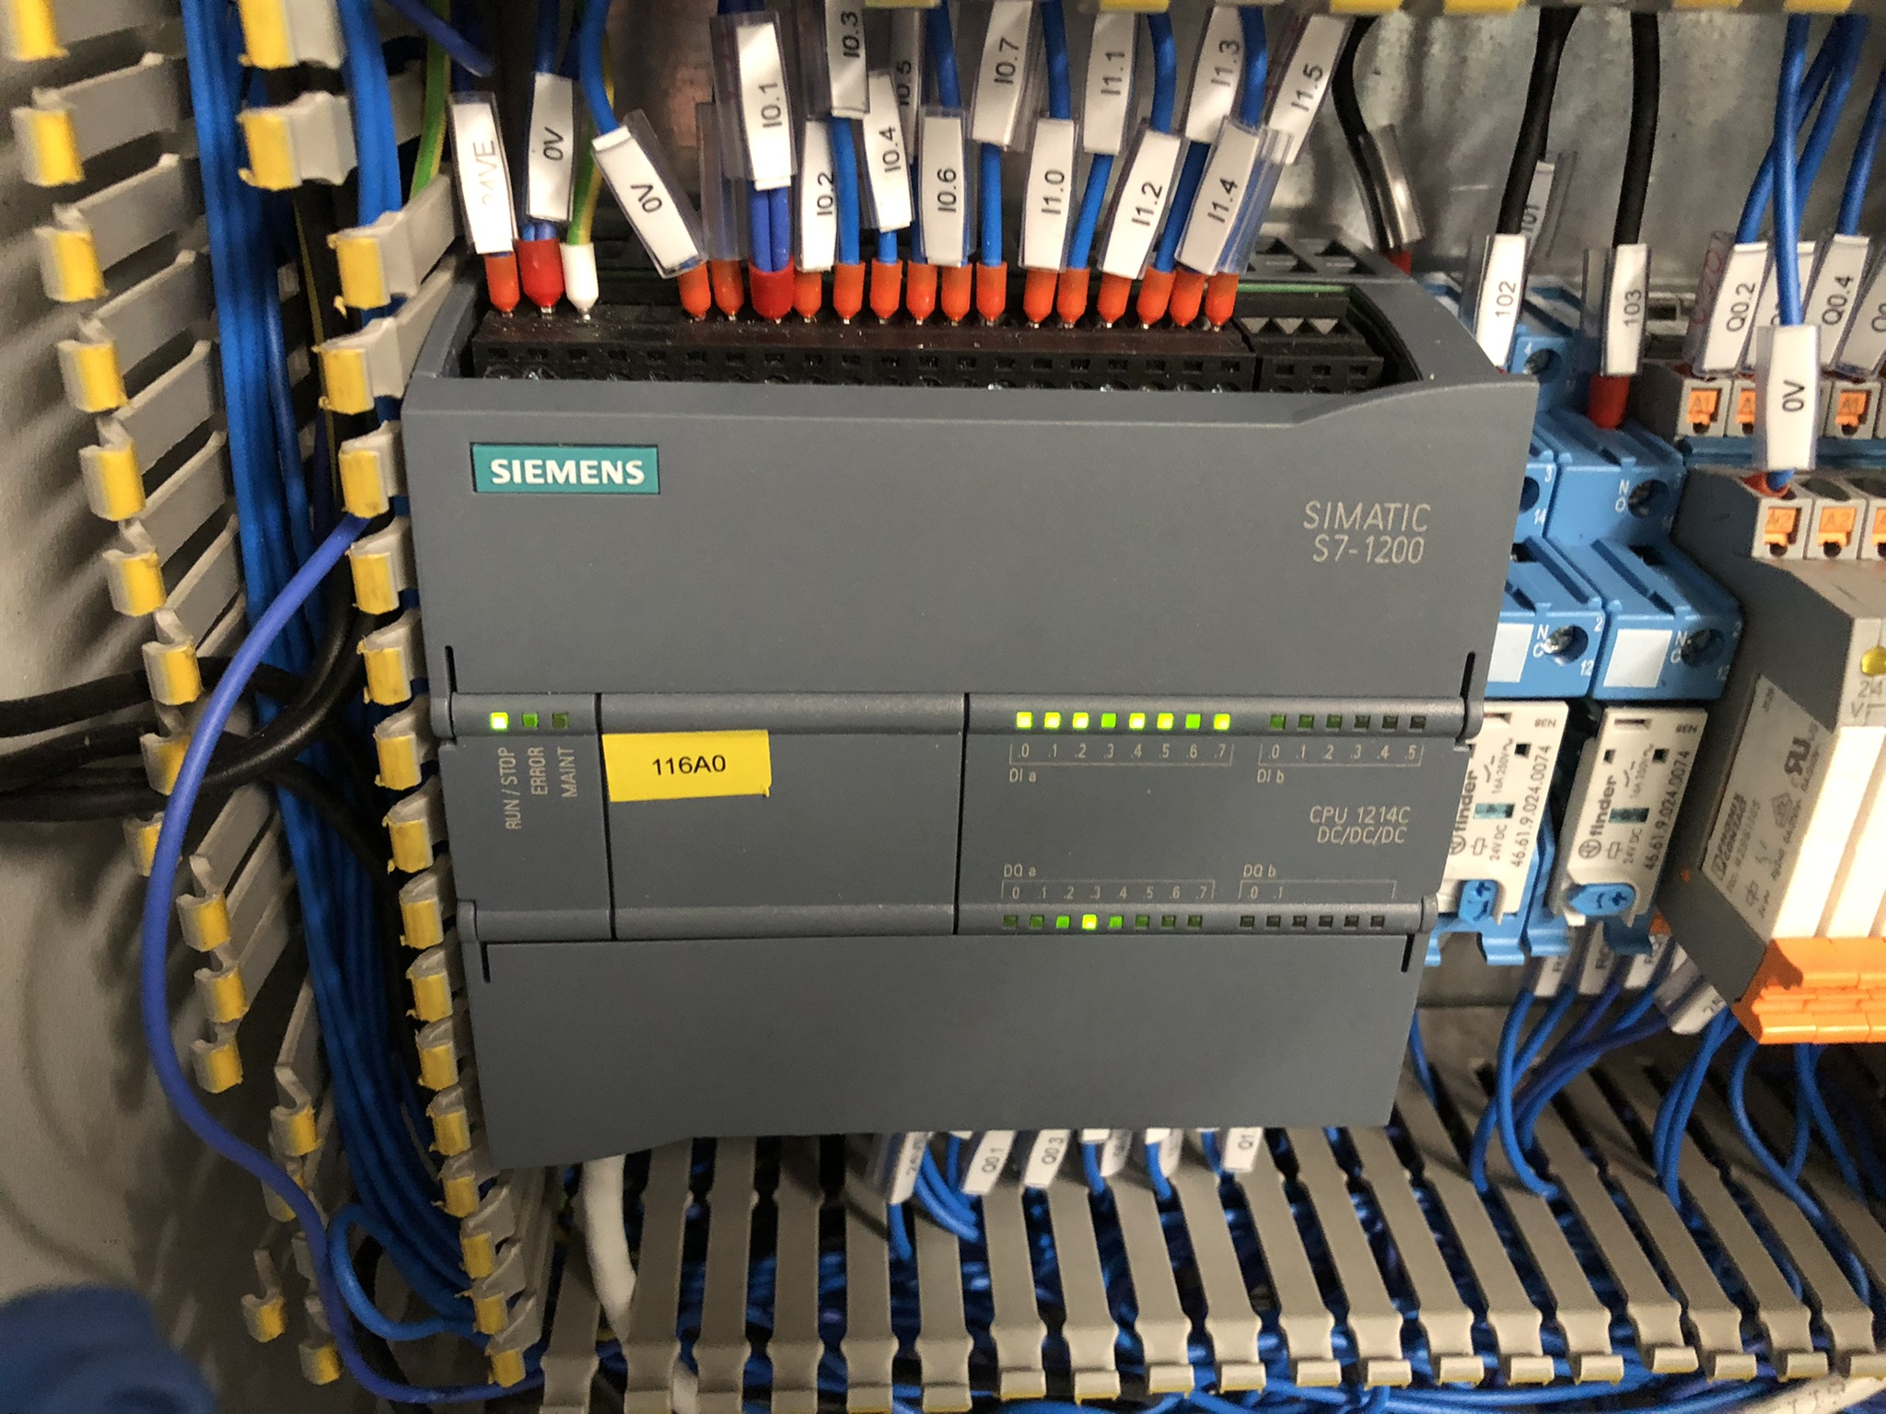
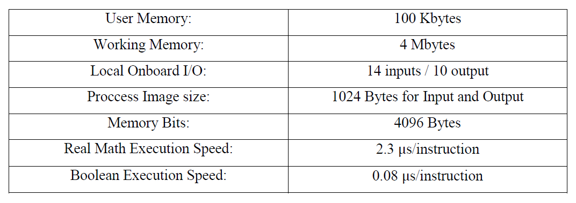
PLC | Specification
Siemens S7-1214 DC/DC/DC PLC used for the system.
Enough input-output for the project. 14 digital input, 2 analog input and 10 digital output.
A model frequently used in the industry.

Slide 15
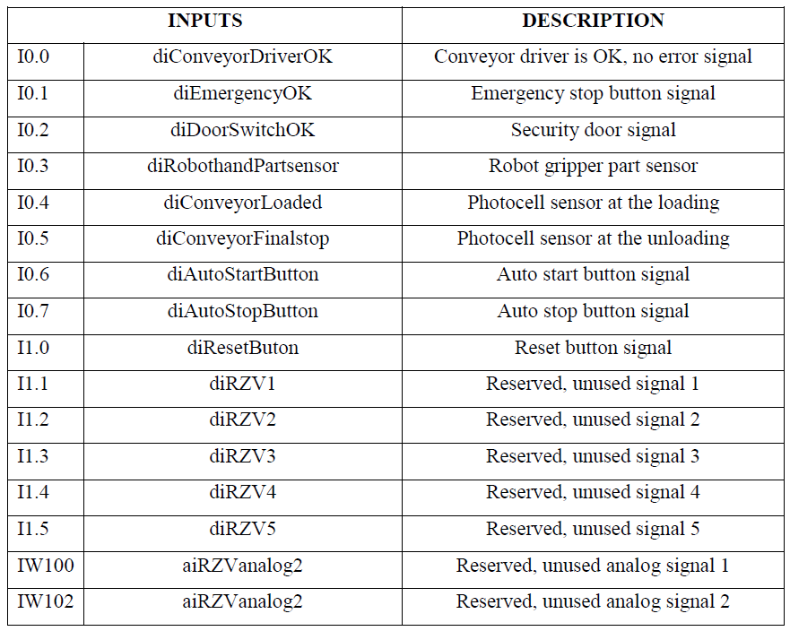
PLC | Inputs
Inputs from the field for programming.
The used inputs can be seen on the table.
Conveyor driver OK, Emergency OK, door switch OK, conveyor loaded sensor, conveyor final stop sensor and auto stop button is normally closed signals. They send ‘1’ to PLC normally.

Slide 16
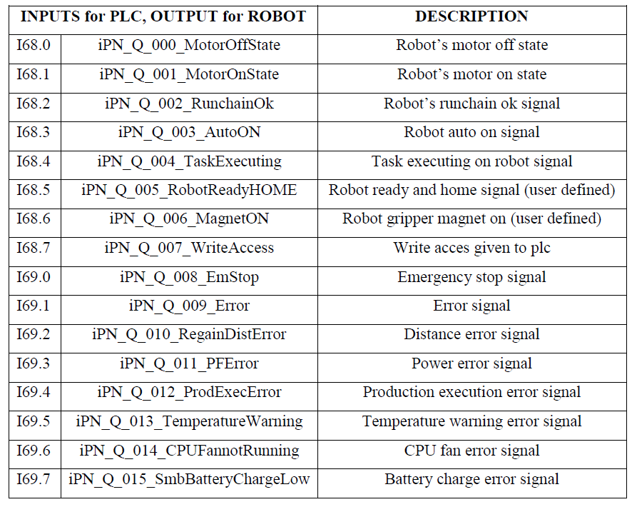
PLC | Inputs from Robot
Inputs for PLC and outputs for the robot.
Not physical signals, communication is ProfiNET based.
Robot’s System outputs and user defined outputs like Magnet ON and RobotReadyHome defined.

Slide 17
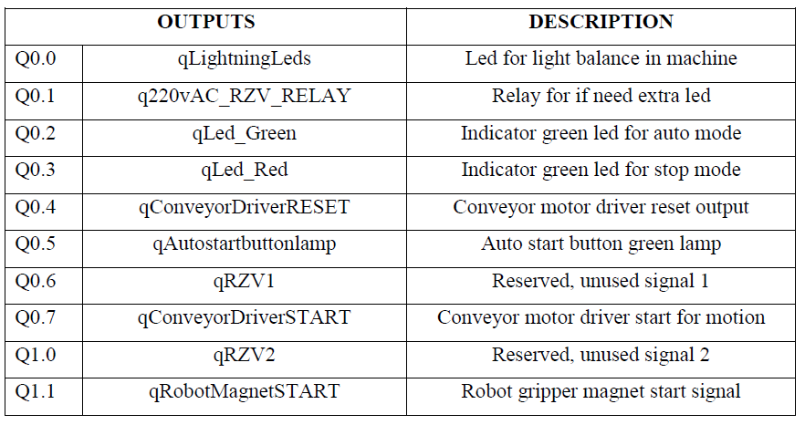
PLC | Outputs
Outputs for the field for programming.
The used outputs can be seen on the table.

Slide 18
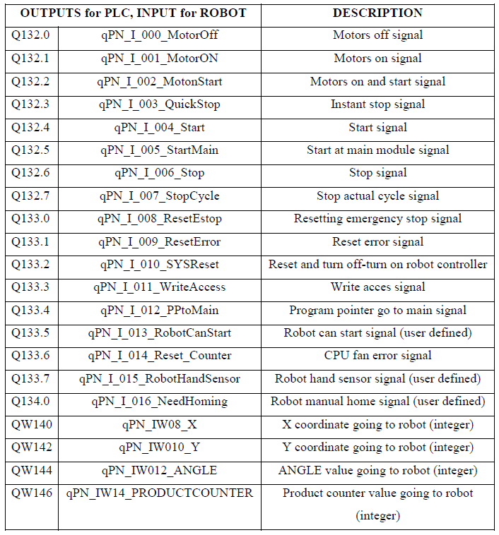
PLC | Outputs from PLC to Robot’s inputs
These signals are outputs for PLC and inputs for the robot.
Not physical signals, communication is ProfiNET based.
Robot’s System inputs and user defined outputs defined.
Coordinate datas of the product are sending here as analog signal.

Slide 19
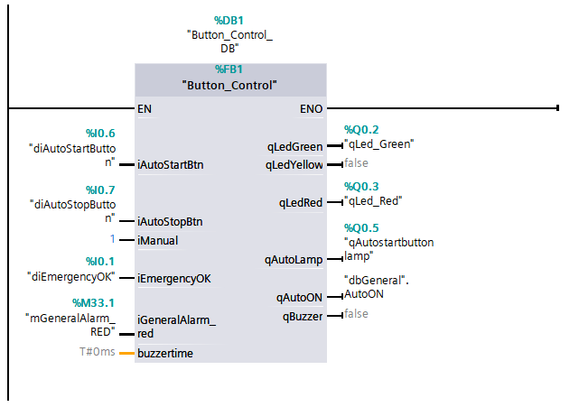
PLC |Programming - Button control function block
Used for controlling the buttons below the HMI screen.
Inputs of this function block: auto start button, auto stop button, emergency button, general alarms
Outputs of this function block: Indicator green and red leds, auto start button lamp, AutoON memory bit for controlling the main system

Slide 20
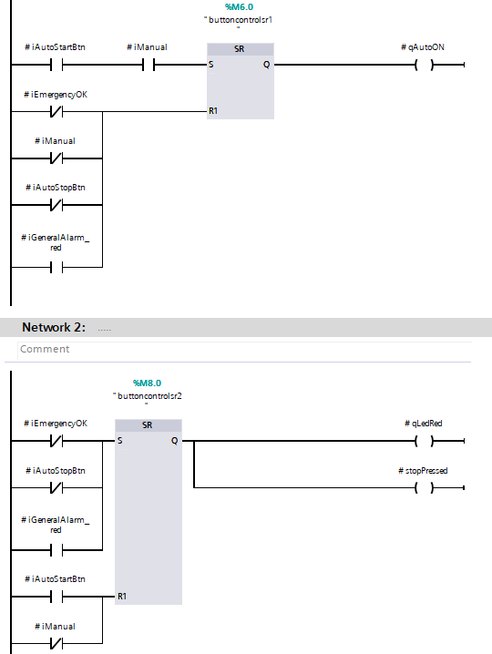
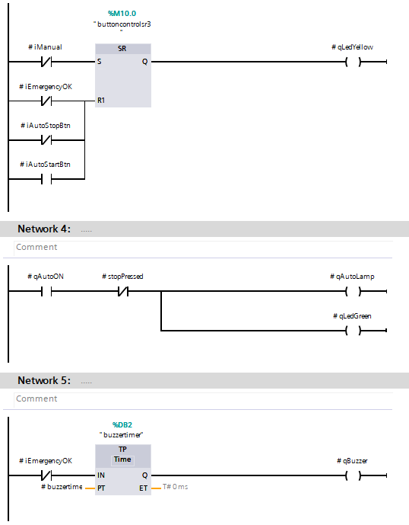
PLC |Programming - Button control function block

Slide 21
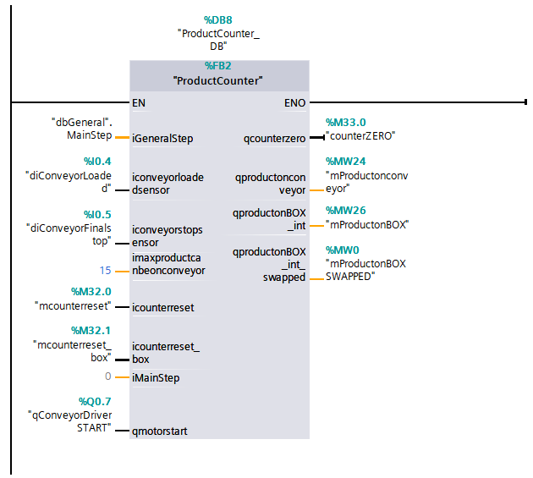
PLC |Programming – Product Counter function block
Used for controlling the product number on the conveyor.
Also used to sending the part number to the Robot for palletizing.

Slide 22
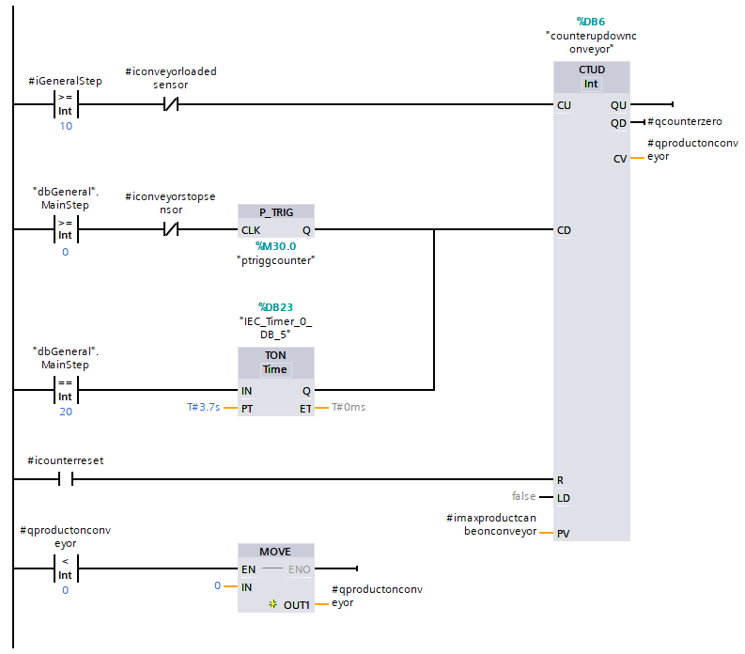
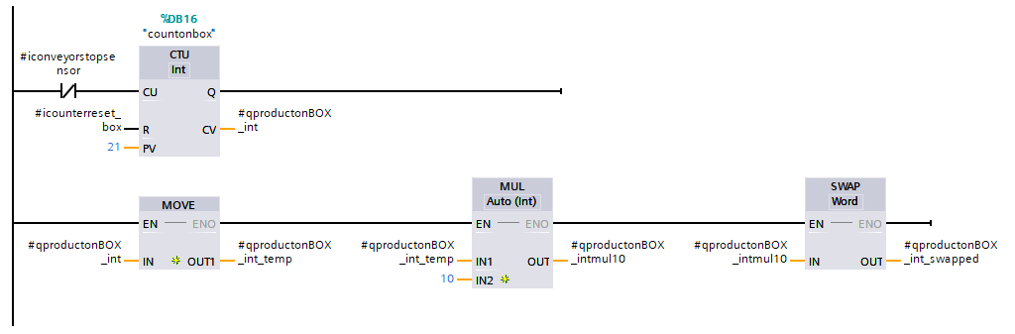
PLC |Programming – Product Counter function block

Slide 23
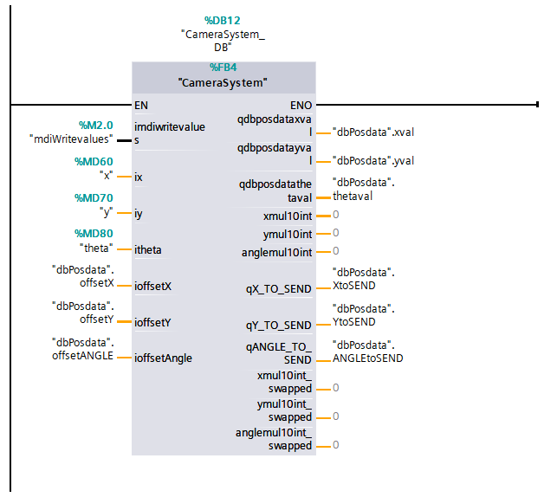
PLC |Programming – Camera System function block
M2.0 signal is recieving from PC (Python) algorithm.
If Python sends the coordinates and angle, the datas writing to the x,y and theta variables in PLC.
The data in the output is the sum of the values with offsets.

Slide 24
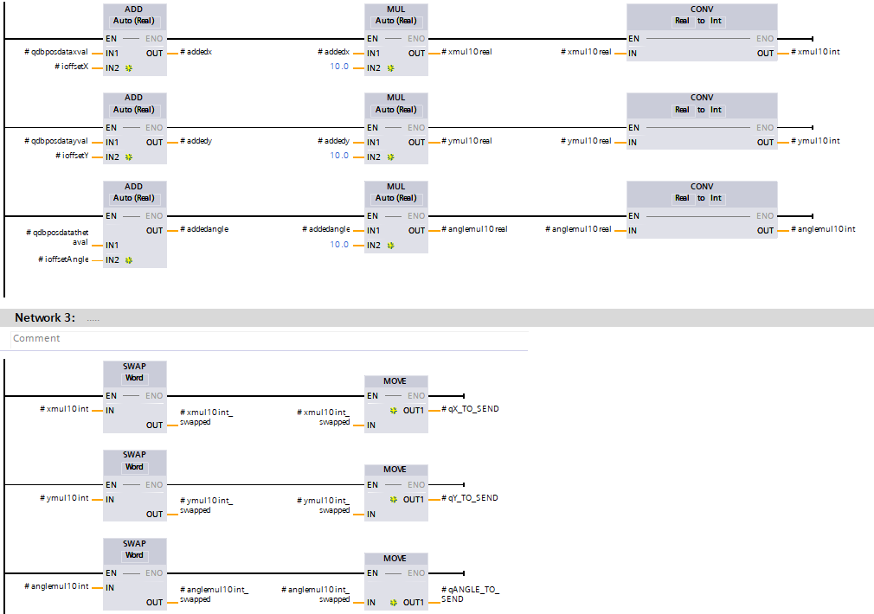
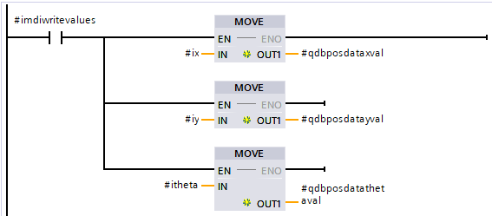
PLC |Programming – Camera System function block

Slide 25
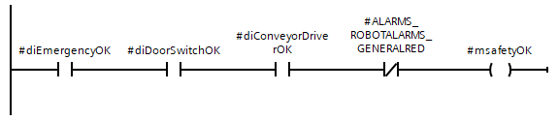
PLC |Programming – Main System
The entire main flow is in this function block.
All inputs and variables are inputs of this function block and also all outputs and variables are outputs of this function block.
Programming with STATE MACHINE and SEQUENTIAL PROGRAMMING.
Realizing state machine with integer variable.
Safety variable for state switching.

Slide 26
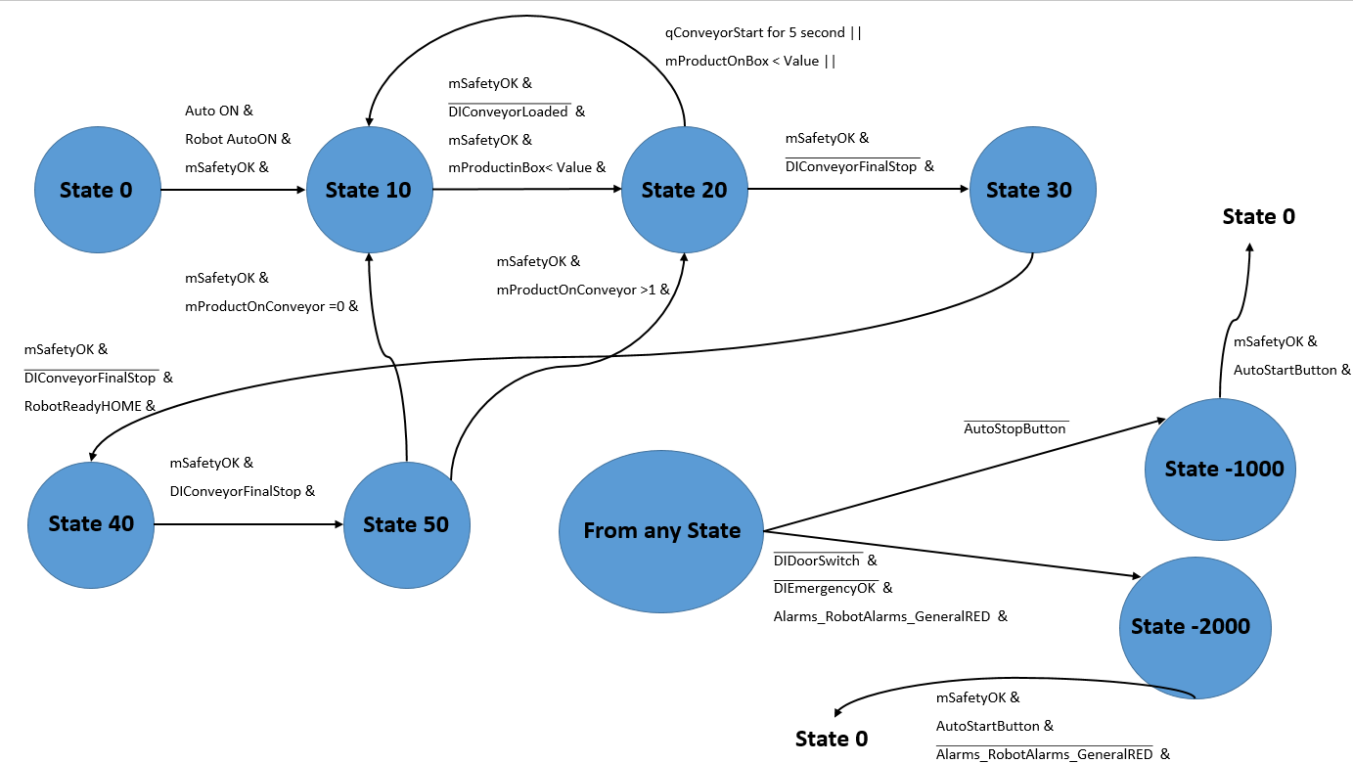
PLC |Programming – State Machine

Slide 27
PLC |Programming – Main System
State 0: Initial state.
State 10: Waiting for the product.
State 20: Conveyor motor start.
State 30: Conveyor motor stop.
State 40: Giving permission to the python algorithm and sending data to plc, sending start robot bit and coordinates to the robot.
State 50: The step that allows the conveyor to continue depending on whether there is a product on the conveyor or not.
State -1000: Stop state.
State -2000: Emergency stop state.

Slide 28
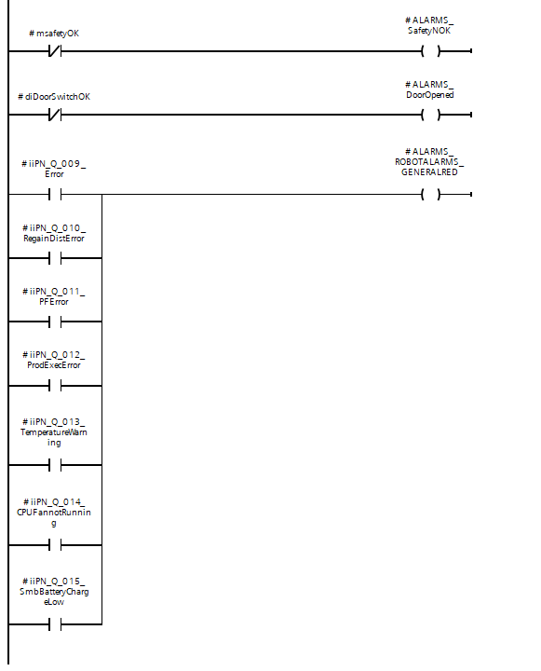
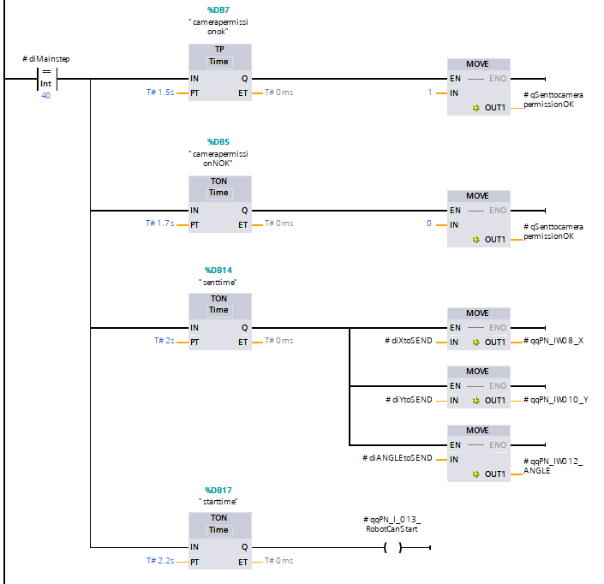
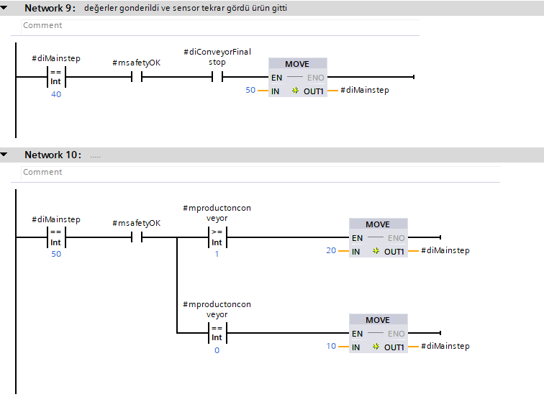
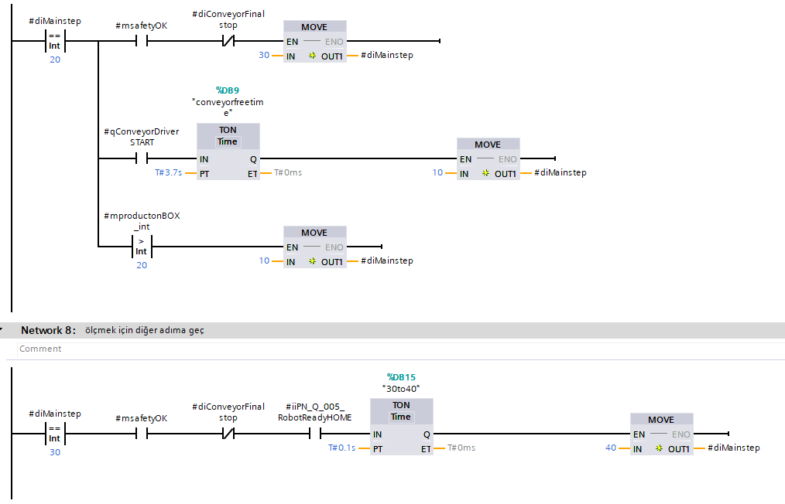
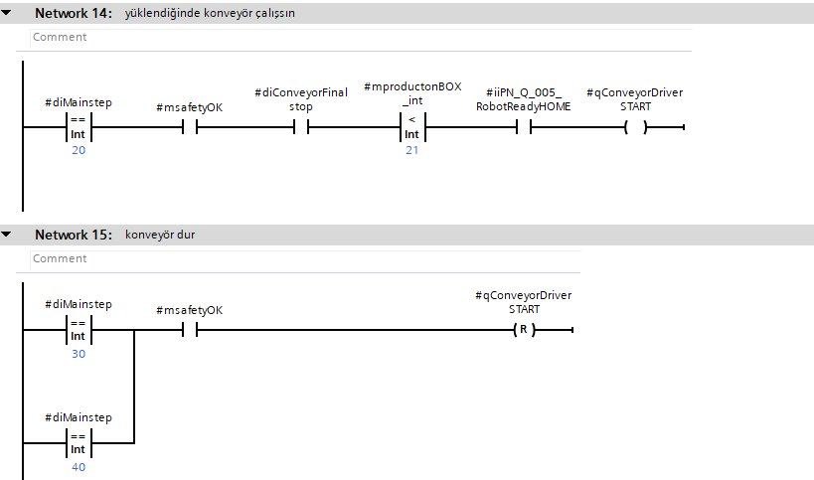
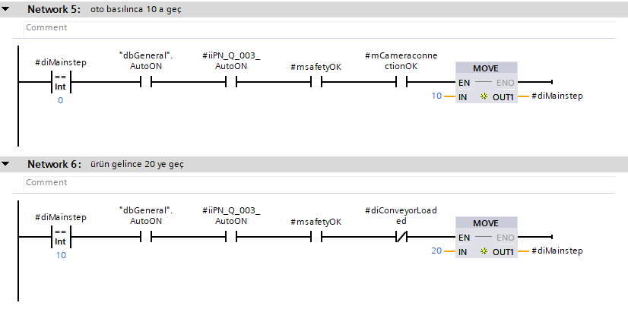
PLC |Programming – Main System

Slide 29
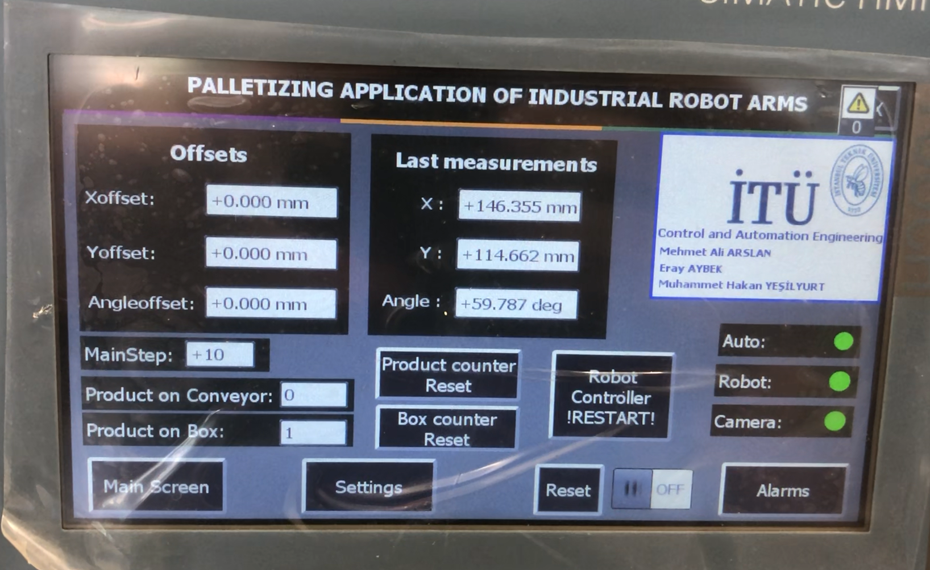
PLC |HMI
Controlling offsets and resetting counters here.
Auto, robot and camera status.
Main step is changable.
Measurements for tracking.

Slide 30
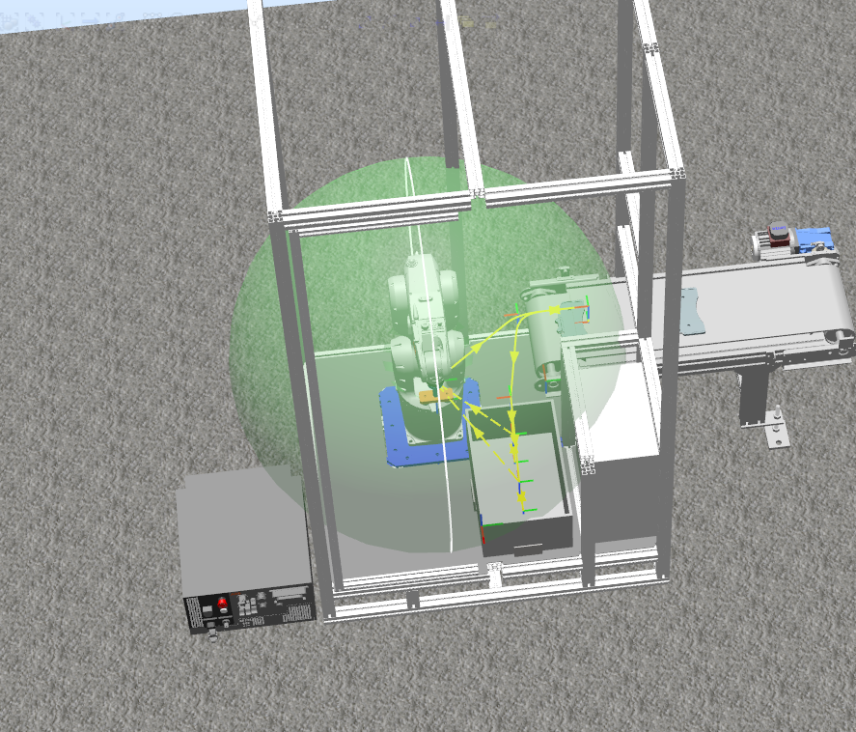
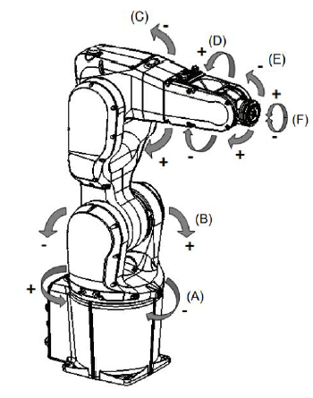
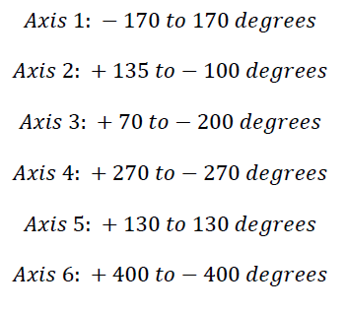
Robot|Specification
ABB IRB1200 0.7 kg- 0.7 meter reach robot manipulator used.
Simulation for checking robot’s working space and location of the conveyor.
Real robot movements on simulation.

Slide 31
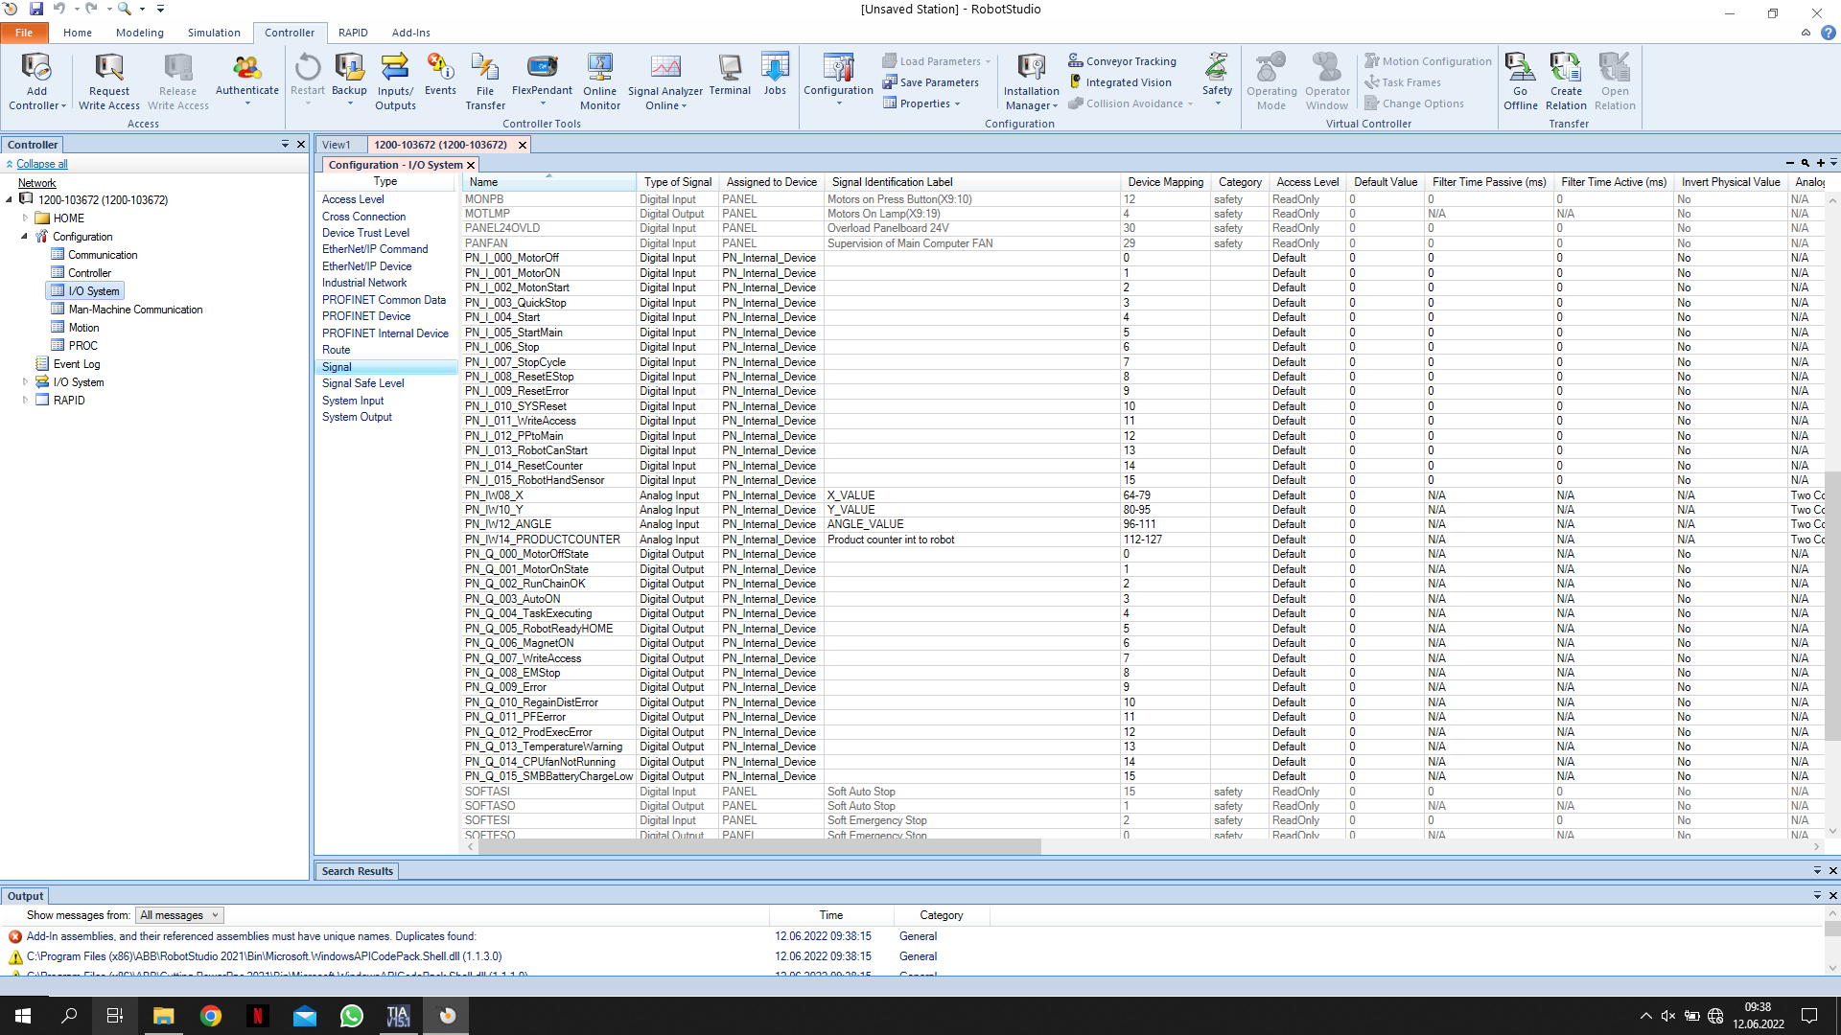
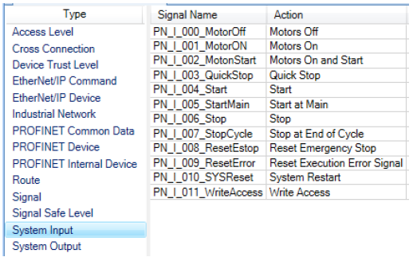
Robot|Inputs
Robots system inputs and user defined variables. Inputs are coming from PLC.
Analog inputs for coordinates, angle and productcounter. 2 Words and 2 bytes for each data.
Mapping for ordering the signals in PLC.

Slide 32
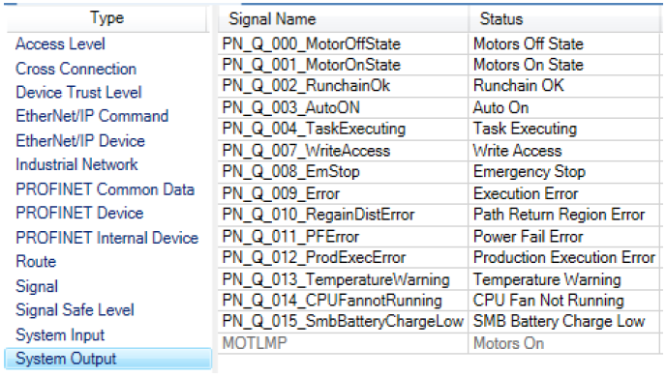
Robot|Outputs
Robots system outputs and user defined variables. Outputs are going to PLC.
Mapping for ordering the signals in PLC.

Slide 33
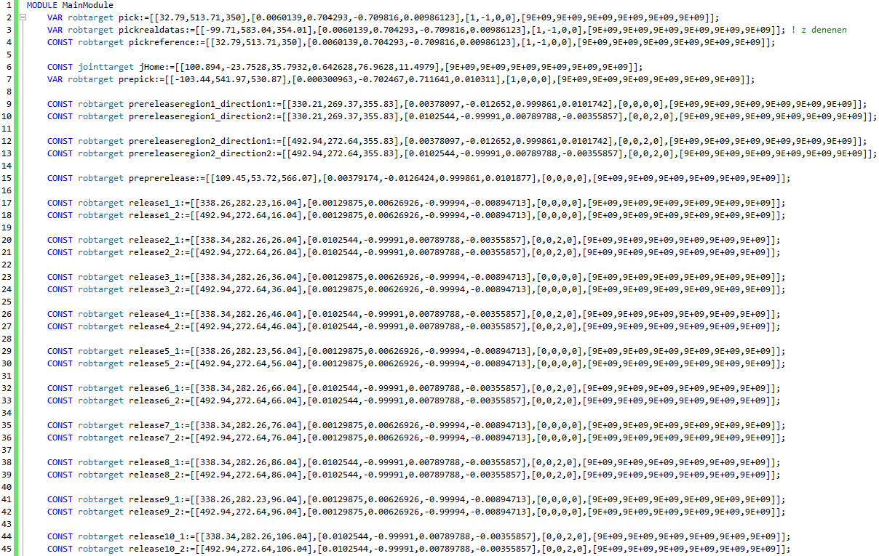
Robot|Programming – Points
Defining all points including orientation, configuration and coordinate datas.
Except for the first drop points and pick points, the other points are programmed by considering the height of the part.
Pickreference point is the same point of camera’s frame left top corner

Slide 34
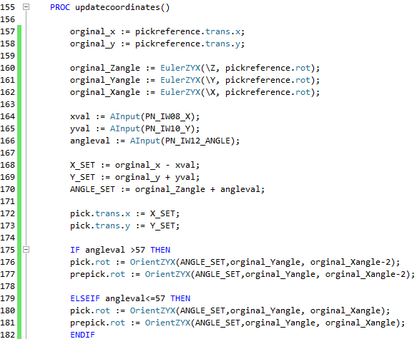
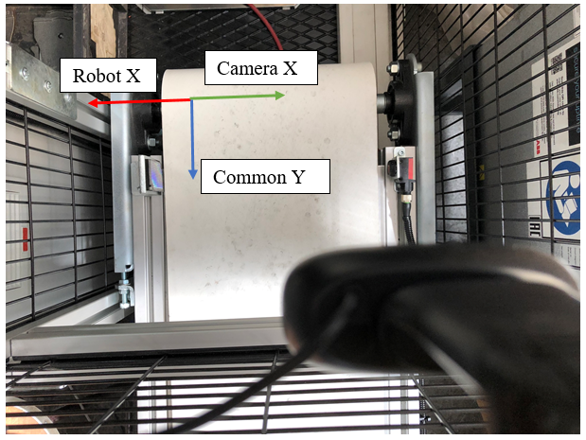
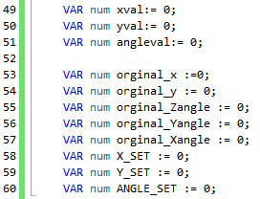
Robot|Programming – Updating pick point
Defining variables,
Defining procedures like functions.
Procedures will be called in main part.

Slide 35
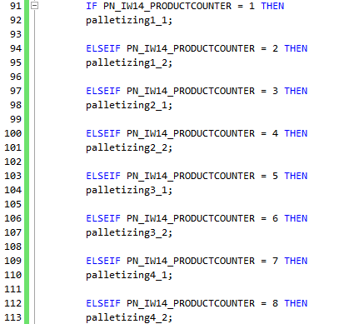
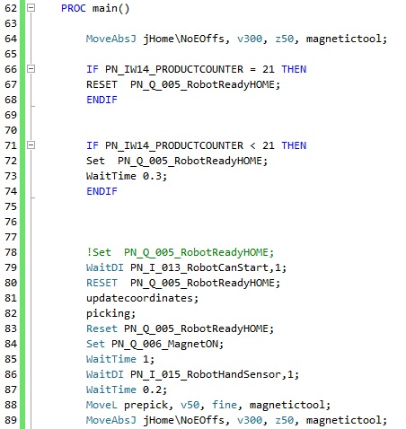
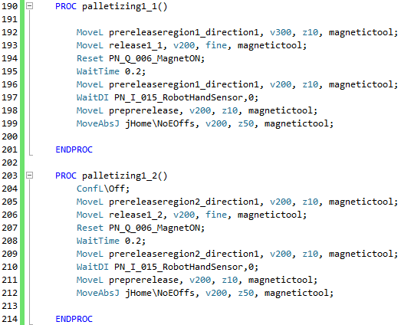
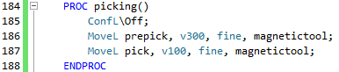
Robot|Programming – Procedures and Main
Picking and palletizing procedures.
Calling procedures from main.

Slide 36
Image Processing
s

